Slide 1
Transport Layer – Part II Chapter 3
Part I
1. Transport Service
2. Elements of Transport Protocols
Part II
3. Internet Protocols – UDP
4. Internet Protocols – TCP
Notes:
In this chapter, we will see TCP and UDP, two primary transport layer protocols, as well as socket programming.

Slide 2
3. Internet Protocols – UDP
Introduction to UDP »
Remote Procedure Call »
Real-Time Transport »
Notes:
UDP, User Datagram Protocol, transport layer protocol.

Slide 3
Introduction to UDP
There are two main protocols in the transport layer
A connectionless protocol: UDP (User Datagram Protocol)
It does almost nothing beyond sending packets between applications
A connection-oriented one: TCP (Transmission Control Protocol)
It does almost everything - makes connections and adds reliability with retransmissions, along with flow control and congestion control

Slide 4
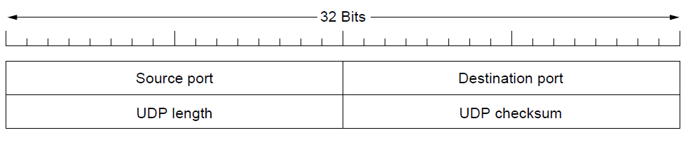
Introduction to UDP (1)
UDP (User Datagram Protocol)
provides a way for applications to send encapsulated IP datagrams without establishing a connection beforehand
is described in RFC 768
A UDP segment consists of an 8-byte header followed by the payload data

Slide 5
Introduction to UDP (2)
UDP (User Datagram Protocol)
Has an efficient header comparing to TCP
Its header contains (64 bits = 8 bytes)
source port,
destination port,
checksum, and
the length of a UDP segment

Slide 6
Introduction to UDP (3)
UDP (User Datagram Protocol)
When a UDP packet arrives, its payload is handed to the application running on the destination port
The source port is needed when a reply must be sent back to the source host
Question: What is the min length of a UDP segment?
Notes:
8 bytes

Slide 7

Introduction to UDP (4)
Min length of an IP header (NH) is 20 bytes
Max length of an IP packet is 65,535
= 2^16 – 1 (bytes)
The max size of a UDP segment is 65,515
= 65,535 – 20 (bytes)

Slide 8
Introduction to UDP (5)
UDP length field includes both
the 8-byte header and
the payload data

Slide 9
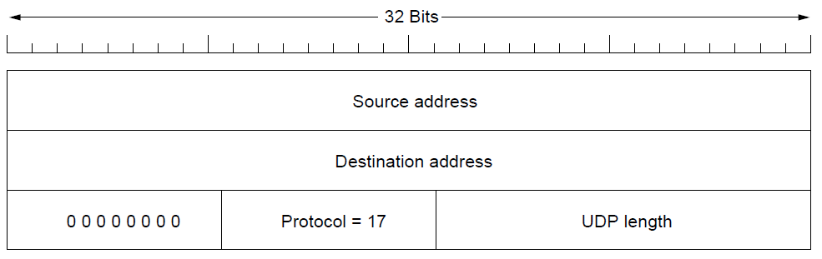
Introduction to UDP (6)
An optional Checksum (16 bits) is also provided for extra reliability
checksums the header, the data, and a conceptual IP pseudo-header
The IP pseudo-header for IPv4 is shown in the figure below
Notes:
Protocol number: TCP = 6; UDP = 17

Slide 10
The IP pseudo-header
source & destination IPv4 addresses
protocol number (an 8-bit field: UDP=17, TCP=6, and IPv4 = 4)
UDP length
padding zeros (8 bits)
Question: Why is an IP pseudo-header included in the UDP checksum?

Slide 11
The IP pseudo header (2)
Including the pseudo-header in the UDP checksum helps detect misdelivered packets
but violates the TCP/IP protocol hierarchy since IP addresses belong to IP layer, not to the trans-layer
Similarly, TCP also uses the same IP pseudo-header for its checksum

Slide 12
4. Internet Protocols – TCP
The TCP service model »
The TCP header »
TCP connection establishment »
TCP connection state modeling »
Notes:
Let’s look at another important transport layer protocol, TCP-Transmission Control Protocol.

Slide 13
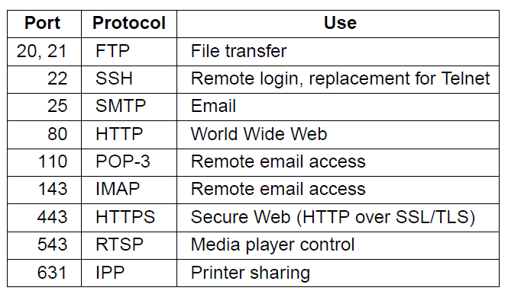

The TCP Service Model
Provides reliable data communication between two processes
Formally defined in RFC 793
Popular servers run on standard TCP ports
Notes:
TCP provides reliable data communication between two processes. There are tons of popular servers running on TCP protocol, such as HTTP, SMTP, SSH, FTP, HTTPs, etc.
POP3 downloads the email from a server to a single computer, then deletes the email from the server.
On the other hand, IMAP stores the message on a server and synchronizes the message across multiple users devices.

Slide 14
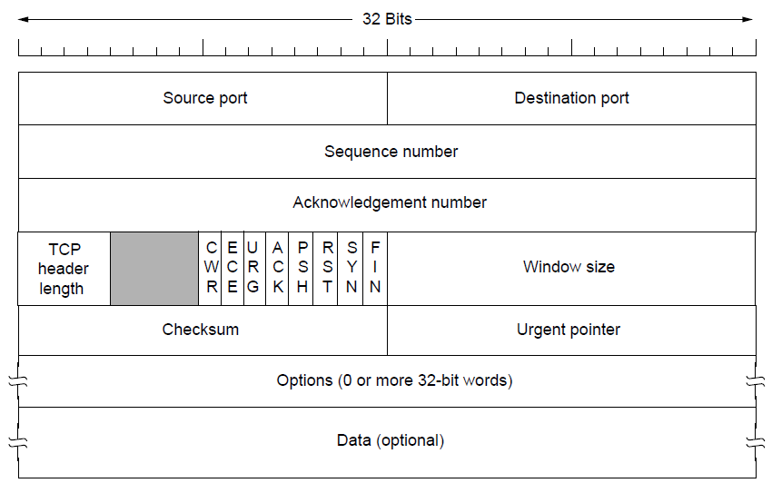
The TCP Header
Each segment begins with a 20-byte header (format fixed)
The header may be followed by 4-type header options
20 bytes
4 bytes
Up to 65,495 bytes
Notes:
TCP header is more complex than UDP header due to flow control and reliable data transfer. As shown here, it is the TCP header. Without counting Options, it has 20 bytes. Segments without any data are legal and are commonly used for acknowledgements and control messages. [Explain each field in this Header]

Slide 15
TCP segments without any data are legal (commonly used for acknowledgements and control messages)
The src port and dst port fields identify the local app end points of the TCP connection
A sequence number identifies a TCP segment’s place in the sequence of data stream, used to keep track of how much data the sender has transmitted
Notes:
TCP header is more complex than UDP header due to flow control and reliable data transfer. As shown here, it is the TCP header. Without counting Options, it has 20 bytes. [Explain each field in this Header]

Slide 16
An acknowledgement number is used to inform the sender that up to this byte of the transmitted data was successfully received
TCP header length (4-bit): # of 32-bit words contained in the header (needed as Options field is of variable length)
Next comes a 4-bit field not used
Notes:
TCP header is more complex than UDP header due to flow control and reliable data transfer. As shown here, it is the TCP header. Without counting Options, it has 20 bytes. [Explain each field in this Header]

Slide 17
Eight 1-bit flags: ECE and CWR bits are used to signal congestion when ECN (Explicit Congestion Notification) is used
ECE bit is set to signal an ECN-Echo from a receiver to inform the sender to slow down transmission when the receiver gets a congestion indication from the network
CWR bit (Congestion Window Reduced) is set to signal from a sender to inform the receiver that transmission has been slowed down, and you can stop sending ECN-Echo

Slide 18
URG is set to 1 if the Urgent pointer is in use (used to indicate a byte offset from the current sequence number at which urgent data is to be found)
ACK bit is set to 1 to indicate that the Acknowledgement number is valid (the segment may contain pushed data). If ACK bit is set to 0, the segment does not contain an Acknowledgement
PSH bit is set to 1 to indicate PUSHed data in the segment

Slide 19
Eight 1-bit flags:
RST bit is used by a server to
abruptly reset a connection that has become confused (due to a host crash/reboot), or
refuse a request connection

Slide 20
SYN bit is used to establish connections:
A connection request has SYN = 1 and ACK = 0 to indicate that the acknowledgement field is not in use
The server reply bears an acknowledgement, and it has SYN = 1 and ACK = 1 if it accepts the request
SYN = 1 indicates either a CONNECTION REQUEST or CONNECTION ACCEPTED, with the ACK bit used to distinguish between the two
FIN bit is used to
release a connection
Notes:
TCP header is more complex than UDP header due to flow control and reliable data transfer. As shown here, it is the TCP header. Without counting Options, it has 20 bytes. [Explain each field in this Header]

Slide 21
TCP flow control: A sender uses a variable-sized sliding window. Sliding window allows the sender to send multiple frames before they are acknowledged
The Window size field tells the sender how many unacknowledged bytes in total can be sent out

Slide 22
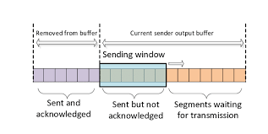
TCP sliding window mechanism of a sender

Slide 23

A Checksum field is mandatory for any TCP segment for reliability
It checksums the header, the data, and a conceptual IP pseudo-header in the same way as UDP does

Slide 24

TCP 3-Way Handshake with SYN/ACK bits
client state
server state
LISTEN
choose init seq num x
send TCP SYN msg
SYN SENT
SYNbit=1, Seq=x
choose init seq num y
send TCP SYN/ACK
msg, acking SYN
SYN RCVD
SYNbit=1, Seq=y
ACKbit=1; ACKnum=x+1
received SYN/ACK(x)
indicates acceptance of
connection request;
send ACK;
this ACK-segment may
contain payload data
ESTAB
ACKbit=1, ACKnum=y+1
received ACK(y)
indicates client is ready to send
payload data
ESTAB

Slide 25
Review Questions
What are the key differences between TCP and UDP?
What is the length of a UDP header? What is the maximum length of a UDP packet?
Give three applications of UDP
Give six application-layer protocols that are on top of TCP
What is the length of a TCP header?
In a TCP header, what is each of the eight 1-bit flags used for?
In a TCP header, what is the Window size field used for?
Why is a TCP header more complex than a UDP header?

